Slide 1
The Formal Elements Art Therapy Scale (FEATS) Digital Archival Project
Emily Budik

Slide 2
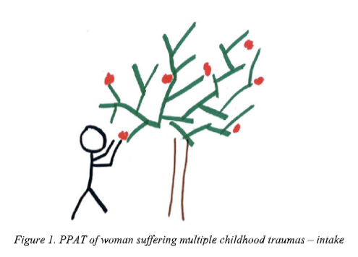
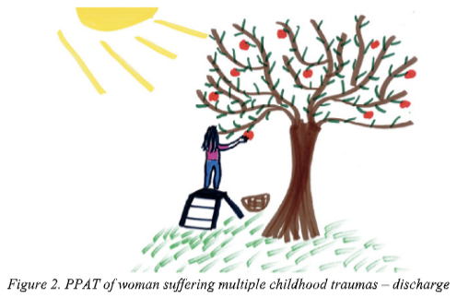
Examples of improvements SEEN in the PPATS
Changes over time seen in
Prominence of color
Realism
Person
Details of Object and Environment
Space
Implied Energy
Gantt, L. & Tabone, C. (2016) The Formal Elements Art Therapy Scale (FEATS). The Wiley Handbook of Art Therapy (pp. 569-578). Gussak, D., Rosal, M.L.

Slide 3
7,498,300
FEATS Numbered Scales
Gantt, L. & Tabone, C. (2016) The Formal Elements Art Therapy Scale (FEATS). The Wiley Handbook of Art Therapy (pp. 569-578). Gussak, D., Rosal, M.L.

Slide 4
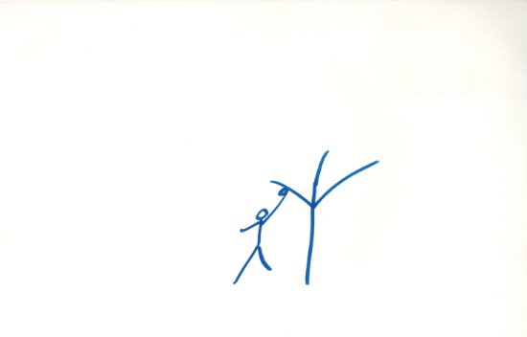
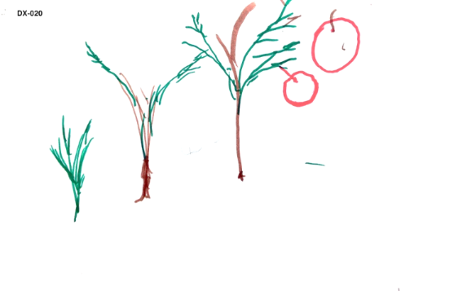
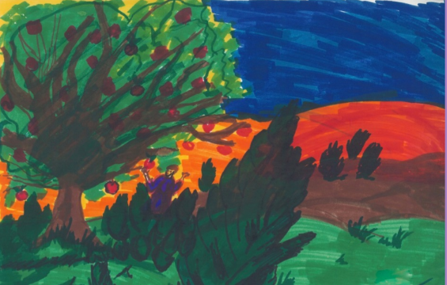
WHAT’S NEXT?

Slide 5
Major Depression
Scales applicable (non-exhaustive)
#3 – Implied Energy
#4 - Space
#10 – Details of Objects and Environment

Slide 6
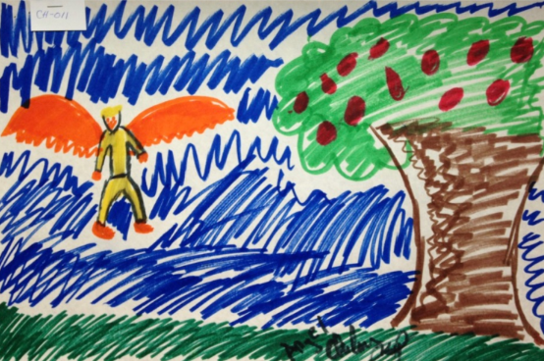
Bipolar Disorder, Mania
Scales applicable (non-exhaustive)
#1 – Prominence of Color
#8 – Problem-Solving
#11 – Line Quality

Slide 7
NOW
PREVIOUSLY
FUTURE
F-800324

Slide 8
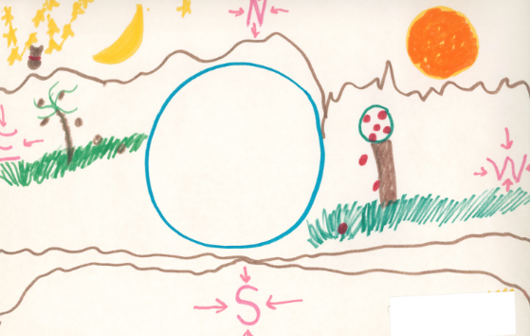
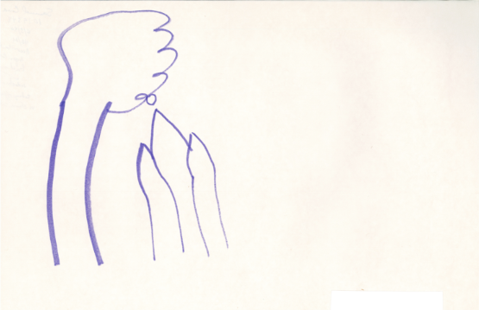
Schizophrenia
Males, 18-25
Scales applicable (non-exhaustive)
#2 – Color Fit
#6 – Logic
#12 - Person

Slide 9
My Ending remarks…
Thank you !

